Slide 1
Summertown & St Margaret’s Neighbourhood Forum
AGM
Tuesday 8 November

Slide 2
AGENDA
Welcome from the Chair, Shamus Donald
CIL & Working Groups update
AGM business
1. Approval of minutes from AGM 2021
2. Treasurer’s Report – Henk van Es, Treasurer
3. Election/Re-election of Steering Committee
4. Approval of revised constitution
5. AOB
7:30 pm – brief break for refreshments followed by:
TRANSPORT
An update on the latest developments and proposals by
ANDREW GANT
County Council Cabinet Member for Highway Management &
City Councillor for Cutteslowe/Sunnymead
+
OPEN FORUM
Meeting ends at 8:30pm

Slide 3
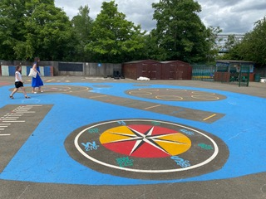
2020 £42k awarded
2021 £25k awarded
2022 £34k awarded
Christmas lights
Jubilee bunting
Alex. Park improvements & mural
CCA kitchen renovation
Library of Things TI camera
Sunnymead Park tables & benches
Cutteslowe School playground improvements
Cutteslowe Children’s summer project
NF publicity project
Community Infrastructure Levy
2023
Applications window opens 16 January

Slide 4
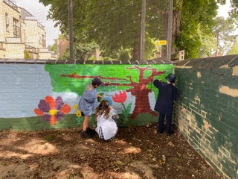
Working Groups
Alexandra Park
Benches, planting & pollinator garden
Mural
Centenary in 2025
Diamond Place
OCC, OUD & NF working together
Health centre a priority
Affordable housing, great design
Transport
Responded to COTP & traffic filters consultation
Lobbying on Woodstock & Banbury funding loss
Planning
Statutory consultee

Slide 5
AGENDA
Welcome from the Chair, Shamus Donald
CIL & Working Groups update
AGM business
1. Approval of minutes from AGM 2021
2. Treasurer’s Report – Henk van Es, Treasurer
3. Election/Re-election of Steering Committee
4. Approval of revised constitution
5. AOB
7:30 pm – brief break for refreshments followed by:
TRANSPORT
An update on the latest developments and proposals by
ANDREW GANT
County Council Cabinet Member for Highway Management &
City Councillor for Cutteslowe/Sunnymead
+
OPEN FORUM
Meeting ends at 8:30pm

Slide 6
1. Approval of Minutes from AGM 2021

Slide 7
2. Treasurer’s Report [1]
Income
Friends of the Forum 512
Collections 230
Roomhire refund 44
CIL Admin & Publicity 2495
CIL Playground Mural 600
Donations Mural 400
Total £4281

Slide 8
2. Treasurer’s Report [2]
Expenditure
ONPA membership 75
Website design 1865
Website subscription 230
Artwork Alex. Park & Diamond Pl. 204
Printer & Terminal 568
Printing 25
Artwork support Mural 330
Paint Playground Mural 495
Total £3792

Slide 9
2. Treasurer’s Report [3]
Summary
Opening Balance 1 November 2021 £2411
Income £4281
Expenditure £3792
Closing Balance 30 October 2022 £2900
Earmarked Funds
CIL Admin & Publicity £927
Playground Mural £175
Total £1102
Free Funds £1798

Slide 10
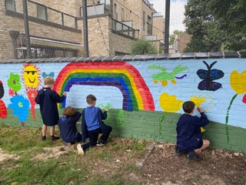
3. Election/Re-election of Steering Committee
Shamus Donald – Chair demitting after two terms
David Nimmo Smith – Dep. Chair standing for re-election, 2nd term
Henk van Es – Treasurer demitting after 2 terms
Natasha Robinson – Secretary standing for re-election, 2nd term
Deborah Bryceson standing for re-election, 2nd term
Bob Colenutt standing for election (currently co-opted)
David Madden elected 2021-2024
Neil MacLennan standing for election (currently co-opted)
Christopher Pownall standing for election (currently co-opted)
Geoffrey Randell standing for re-election, 2nd term
Ex-officio:
Councillor Laurence Fouweather [City Council]
Councillor Andrew Gant [City & County Councils]
Councillor John Howson [County Council]
Councillor Tom Landell Mills [City Council]
Councillor Katherine Miles [City Council]

Slide 11
4. Approval of Revised Constitution
Abbreviated name of Forum as ‘SuStM’
Registration for membership also via the website
Open Public Meetings a minimum of twice [not three times] a year
Addition of Cutteslowe Community Centre to publicity noticeboards [with NOA & SMI]
No mailing of information, only emailing [to registered members]
Removal of transitional arrangements for 2015015

Slide 12
5. AOB

Slide 13
An update on the latest developments and proposals by ANDREW GANT County Council Cabinet Member for Highway Management & City Councillor for Cutteslowe/Sunnymead
TRANSPORT

Slide 14
OPEN FORUM

