Slide 1
Summertown & St Margaret’s AGM – Wednesday 10 November 2021 at 7pm
AGENDA
Welcome from the Chair, Shamus Donald
Review of 2020/21
AGM business
Approval of minutes from AGM 2020
Treasurer’s Report – Henk van Es, Treasurer
Election/Re-election of Steering Committee
AOB
followed by:
Diamond Place
7.30pm – The Forum’s proposals for a Community Plan
7.45pm – Oxford University Development’s latest thinking from
ANNA STRONGMAN, CEO
8pm – Q&A

Slide 3
Steering Group Members
Shamus Donald – Chair 2016-2019, re-elected 2020-2022
Bob Colenutt 2015-2018, re-elected 2018-2021
Henk van Es – Treasurer 2016-2019, re-elected 2020-2022
Deborah Bryceson 2020-2022
David Nimmo Smith 2020-2022
Natasha Robinson – Secretary 2020-2022
Geoffrey Randell 2020-2022
Ex-officio:
Councillor Laurence Fouweather [City Council]
Councillor Andrew Gant [City & County Councils]
Councillor John Howson [County Council]
Councillor Tom Landell Mills [City Council]
Councillor Katherine Miles [City Council]

Slide 4
Community Infrastructure Levy
2020
£42k awarded to seven applicants
2021
£25k awarded to seven applicants:
Summertown cycle parking
Marston Ferry allotments
Breastfeeding support
SMI flooring
Church welcome garden
Pollinator garden
Christmas lights
2022
£27k available at present

Slide 5
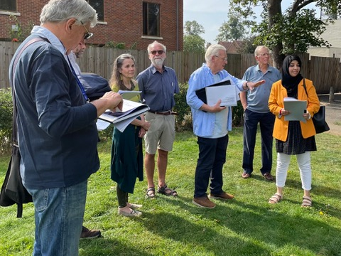
ALEXANDRA PARK
Tree planting
Better play surfaces
More seating
Pollinator garden
Sensory garden planned
Centenary in 2025

Slide 6
New Working Groups
DIAMOND PLACE
Led by Bob Colenutt
Community Plan drafted
Liaising with OUD & OCC
TRANSPORT
Led by Deborah Bryceson
WR & BR Corridor Study
Initial parking survey for DP
+ PLANNING WORKING GROUP

Slide 7
Summertown & St Margaret’s AGM – Wednesday 10 November 2021 at 7pm
AGENDA
Welcome from the Chair, Shamus Donald
Review of 2020/21
AGM business
Approval of minutes from AGM 2020
Treasurer’s Report – Henk van Es, Treasurer
Election/Re-election of Steering Committee
AOB
followed by:
Diamond Place
7.30pm – The Forum’s proposals for a Community Plan
7.45pm – Oxford University Development’s latest thinking from
ANNA STRONGMAN, CEO
8pm – Q&A

Slide 8
SuStM Financial Report
Opening Balance 1 November 2020 £2,229.21
Income
Friends of the Forum 595.00
Oxford County Council 500.00
Cake Sale 150.00
Total 1,245.00
Expenditure
Website 654.99
Diamond Place 306.16
Meetings 103.00
Total 1,064.15
Closing Balance 30 October 2021 £2,410.06

Slide 9
Summertown & St Margaret’s AGM – Wednesday 10 November 2021 at 7pm
AGENDA
Welcome from the Chair, Shamus Donald
Review of 2020/21
AGM business
Approval of minutes from AGM 2020
Treasurer’s Report – Henk van Es, Treasurer
Election/Re-election of Steering Committee
AOB
followed by:
Diamond Place
7.30pm – The Forum’s proposals for a Community Plan
7.45pm – Oxford University Development’s latest thinking from
ANNA STRONGMAN, CEO
8pm – Q&A

