Slide 1
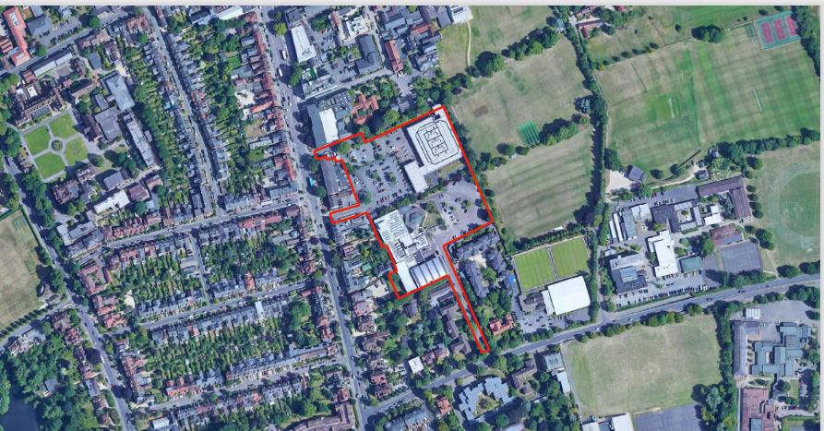
THE CASE FOR DIAMOND PLACE

Slide 2
WHAT IS HAPPENING TO OXFORD?
MASSIVE EXTENSIONS TO THE NORTH AND SOUTH

Slide 3
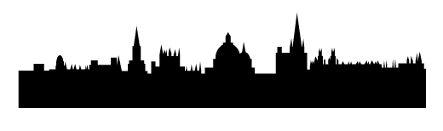
KIDLINGTON GAP DEVELOPEMENT
GOLF CLUB DEV
BARTON 1
BARTON 2
NORTH OXFORD DEVELOPMENT
FRIDESWIDE FARM DEV
CANALSIDE DEV
SUMMERTOWN
OXFORD
GRENOBLE ROAD DEVELOPMENT

Slide 4
THESE EXTENSIONS ARE NEEDED BUT THEY ARE OFTEN NOT SUITABLE FOR:
PEOPLE WHO REQUIRE COMMUNITY SUPPORT
RESIDENTS WITHOUT CARS
OLDER FOLK
ALSO…
THESE EXTENSIONS HAVE NO HEART

Slide 5
WHAT MAKES A HEART?
COMMON GREEN SPACE
PUBS
SHOPS
HEALTH CENTRE
LEISURE CENTRE
A PLACE TO MEET
RESTAURANTS
BUS CONNECTIONS
CHURCHES
COFFEE SHOPS
COMMUNITY CENTRE
FOCAL POINT; BAND STAND?

Slide 6
Summertown clearly has a heart but it is under pressure and could do with some life support

Slide 7
THE CASE FOR DIAMOND PLACE
Make sure Summertown’s heart is supported this is an opportunity to encourage the owners to look beyond mere building and individual site development with ambitious ideas for wellbeing through neighbourliness and community .

Slide 8
AND ALSO PROVIDE:
A mix of housing of which 50% would be affordable (80% of which will be social rent), including housing for the elderly.
A new community centre.
Green public open space.
Car parking.
A 21st century health centre.

Slide 9
WHAT TO DO NOW
Develop a wide-ranging, comprehensive master-plan based on a co-design process between:
OXFORD CITY COUNCIL
OXFORD UNIVERSITY DEVELOPMENT
LOCAL COMMUNITY
Informed by consultation with all stakeholders.

Slide 10
THEN:
IDENTIFY PRIORITIES AND IF NECESSARY:
DEVELOP PLAN IN PHASES
Diamond Place with its health and community centre cannot wait for another
5+ years.

Slide 11
The objective of the Community Plan campaign is to press for a development of Diamond Place based on a holistic and potentially award winning 21st century design.

Slide 12
ASPECTS TO BE
CONSIDERED.

Slide 13
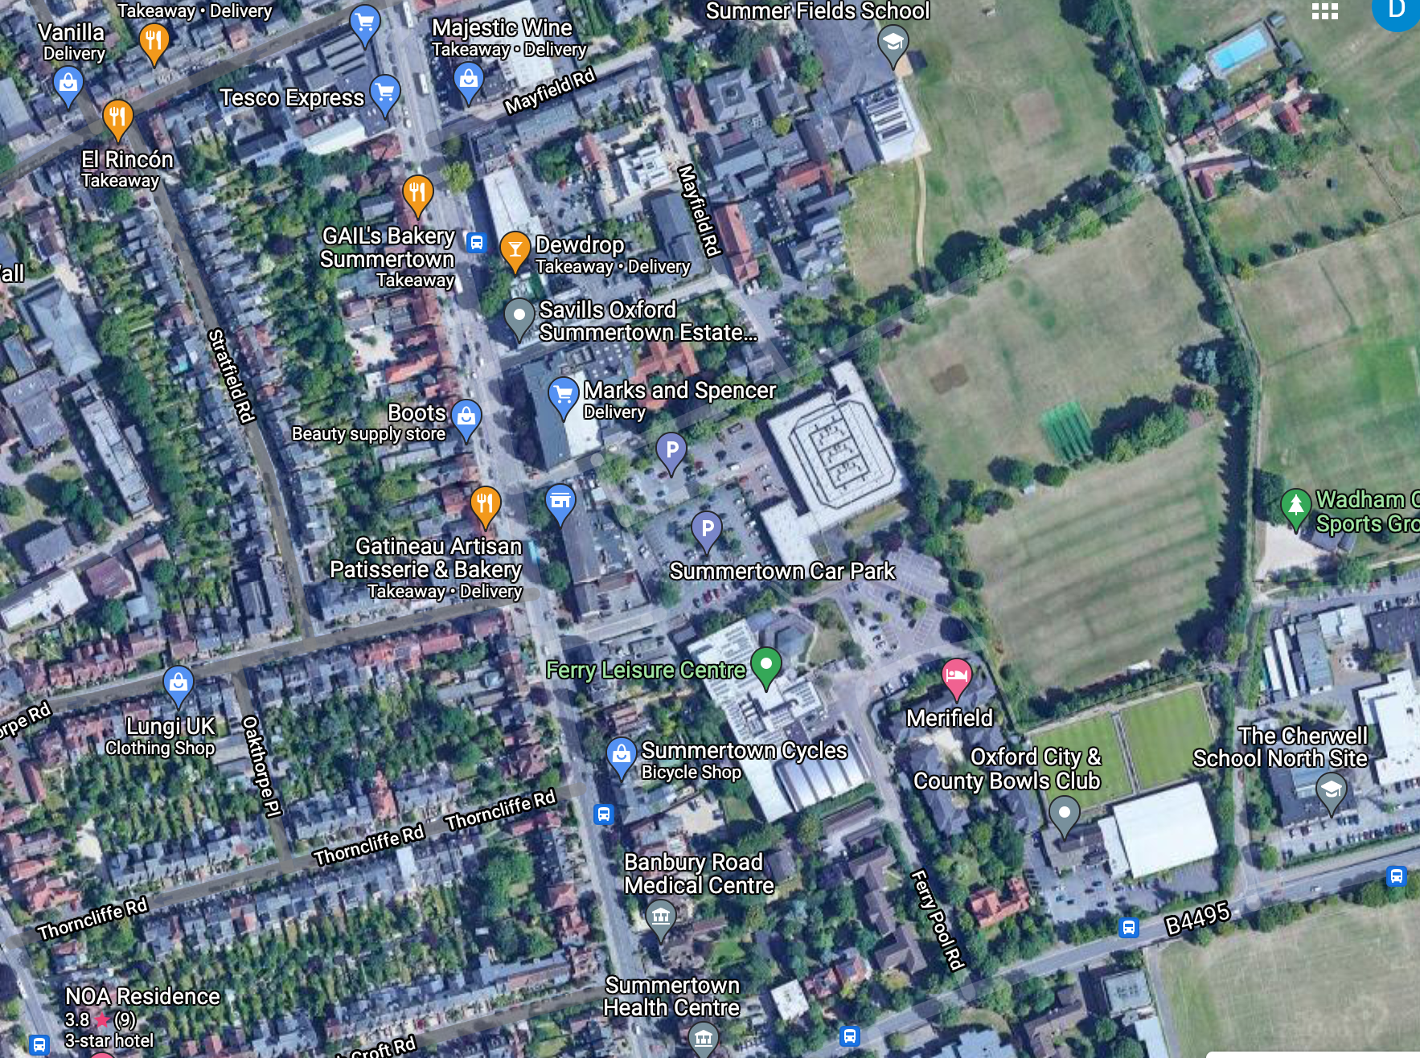
DIAMOND PLACE – THE BIGGER PICTURE
WELL-CONNECTED, PERMEABLE, DELIGHTFUL, SAFE, NEIGHBOURLY, BIO & PEOPLE DIVERSE, LOW ENERGY = SUSTAINABLE & LONG LASTING

Slide 14
EWERT PLACE
NORTH ENTRANCE
TRANSPARENT FACADES AND ACTIVE EDGES. DEVELOPMENT OPPORTUNITIES FOR THE ENTRANCE TO PUBLIC CAR PARK.
FERRY POOL ROAD
SOUTH ENTRANCE
SAFE TURNING LANE. TREE-LINED. WELL-LIT BOULEVARD. TRAFFIC CALMING. ON-STREET PARKING.
DIAMOND PLACE
MIDDLE ENTRANCE
TREE-LINED. WELL-LIT BOULEVARD TO FOCAL POINT. GREENED-UP ENTRANCE GABLES. PRIORTY WALKING AND CYCLING.
NO ENTRANCE TO CAR PARK.

Slide 15
SHARED STREET
CALMING, SURFACE DETAIL
10 MPH LIMIT
PEDESTRIAN AND CYCLE PRIORITY DOG-LEG CROSSING
WITH SURFACE DETAIL
PLANT TREES TO ENRICH CORNER TO OAKTHORPE ROAD

Slide 16
LANDMARK ENTRANCE
RICH CORNER FACADES TO ADJACENT HOUSING
COMMUNITY GREEN
WINDOWS TO GYM
FOR ACTIVE EDGE

Slide 17
HEALTH, COMMUNITY CENTRE & PUBLIC CONVENIENCES
FACING THE GREEN
HOUSING
FRONT DOORS ON TO STREET AND BALCONIES
LEISURE CENTRE
TRANSPARENT FACADES

Slide 18
CYCLE & PEDESTRIAN ROUTES LINK TO SCHOOL
FROM SUNNYMEADE AND CUTESLOWE
WITH SECURE RAILINGS TO EDGES
RESTRICTED ACCESS
LANDMARK FEATURE
FOUNTAIN
RICH FACADES & CORNERS TO ADJACENT BUILDINGS
PRINCIPAL ROUTES
WITH CALMING, SURFACE DETAIL, 10 MPH LIMIT

Slide 19
POST GRADUATE HOUSING
COMMUAL GARDENS
ENTRANCES ON TO STREETS
CHERWELL SCHOOL
1850 PUPILS
SINGLE ASPECT HOUSING TO BACK OF SHOPS
HOUSING ABOVE & AROUND PARKING
FRONT DOORS ON TO STREETS

Slide 20
AND THEN THERE IS PARKING

Slide 21
Summary;
-We offered our first attempt at addressing the bigger picture for your consideration.
-It is ambitious and far-reaching.
-It illustrates ingredients for wellbeing and a safe place.
-It shows how cooperation and team-work could produce a place of community and neighbourliness for the benefit of the wider public interest.
-It contains the basic conditions and environment which will frame an enduring place and well-designed buildings fit for the 21st century.

Slide 22
LET’S DISCUSS

