Slide 1
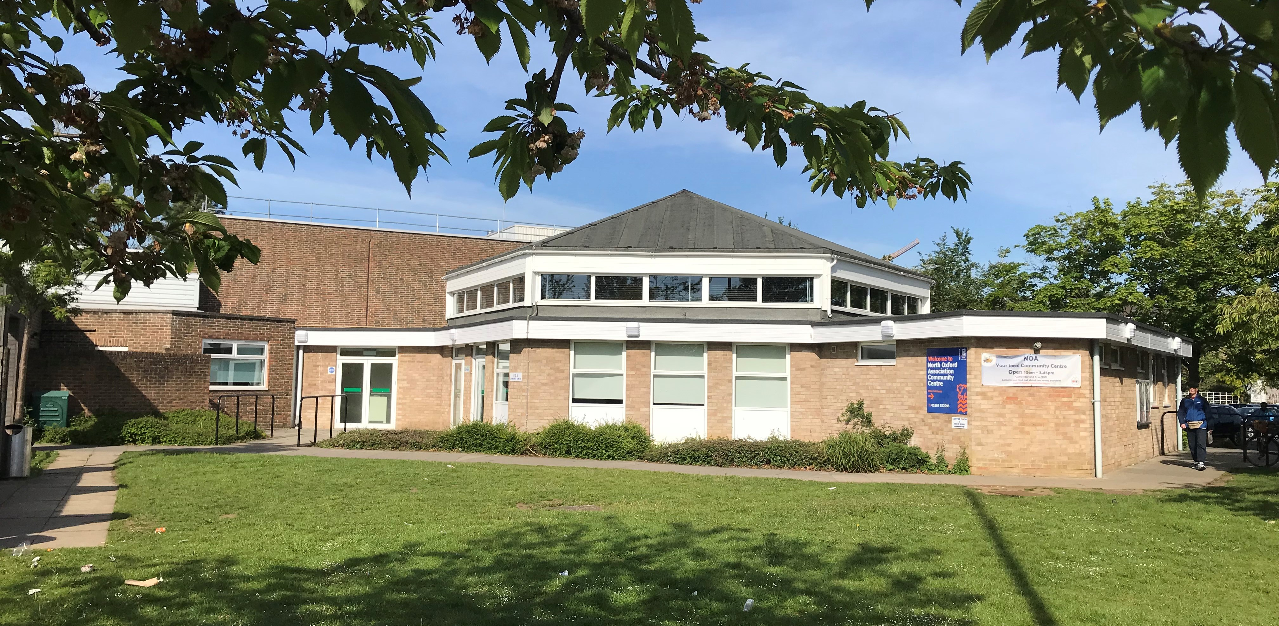
North Oxford Association
Community Centre

Slide 2
Our History
North Oxford Association (NOA) was founded in 1966 but did not have a permanent home
The North Oxford Association Community Centre was built in 1971 and became known as the Ferry Centre
1976 the Ferry Pool opened, due in large part to fund-raising from NOA members.
The Centre received extensive refurbishment in 2004 transforming it into its current form and emphasising its separation from the Pool, now a Council-run sports centre
In 2006 NOA builds an additional space, the Annexe

Slide 3
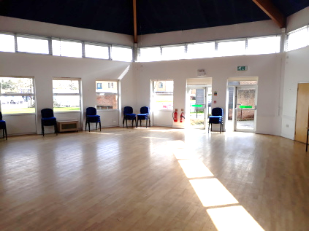
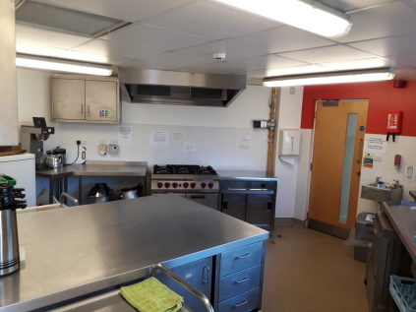
Our spaces
Main Hall
Capacity: 100 (50 seated)
Size: 78m²
Most common activity: Social
Limitations:
No storage for chairs tables etc. impossible to blackout.
Kitchen
Capacity: 4
Size: 15m²
Most common activity: Social
Limitations:
Cramped, underused.

Slide 4
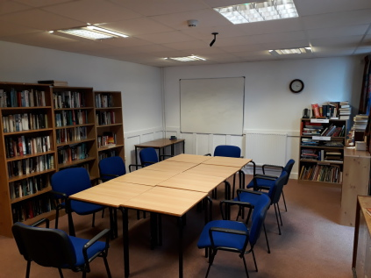
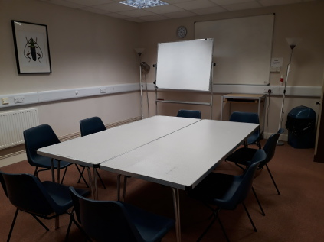
Library
Capacity: 25
Size: 27m²
Most common activity: Art/Education
Lecture room
Capacity: 20
Size: 24m²
Most common activity: Education
Limitations: Odd shape, limited storage, no natural lighting

Slide 5
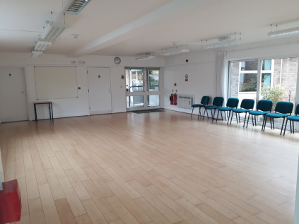
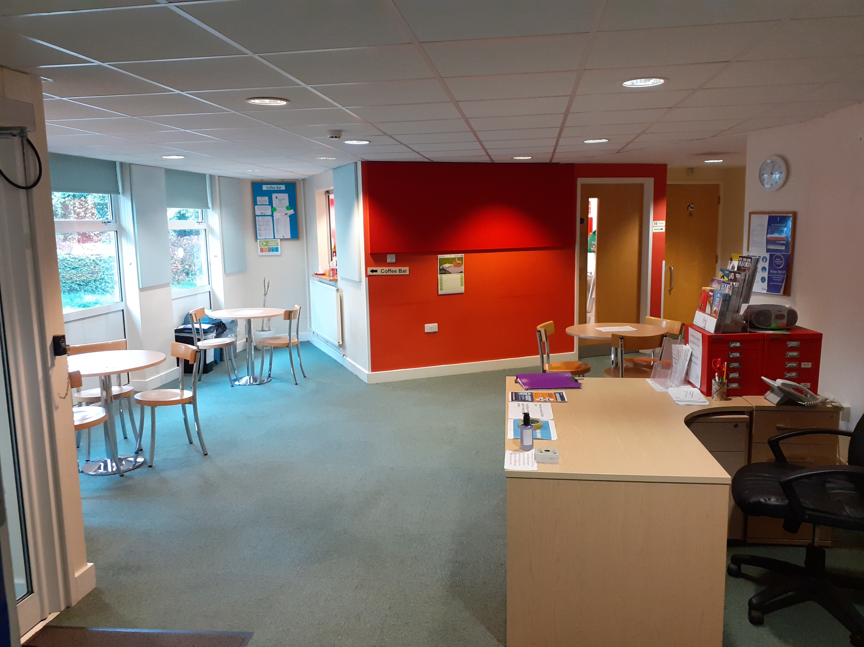
Annexe
Capacity: 20 active / 50 seated
Size: 63m²
Most common activity: Fitness
Limitations: Limited access to amenities, Plain, very limited wall space.
Foyer/Café
Capacity: 15
Size: ?m²
Most common activity:
Social/waiting area
Limitations: Small, difficult shape, echo dampeners

Slide 6
Who uses the NOA Centre
OX2 | 513
OX1-4 | 324
other OX | 221
Rest of UK | 93
TOTAL | 1151

Slide 7
OX2 | 315
OX1-4 | 68
Other OX | 52
Rest of UK | 3
TOTAL | 438

Slide 8
What the NOA Centre is used for
Education | 11
Fitness | 16
Art | 16
Social | 8

Slide 9
When the NOA Centre is used
Monday | 249
Tuesday | 140
Wednesday | 158
Thursday | 258
Friday | 241
Weekend | 276
TOTAL | 1322

Slide 10
When are The NOA Centre busy periods

Slide 11
Things we would like to do but cannot in our current space
Be a better place for meeting and mingling
Make better use of our kitchen area
Be able to display the work of local artists
Provide specialised art facilities

